Slide 1


Azure App Services
November 17/11/2018, 2018

Slide 2

Agenda
What are App services?
Web apps
API apps
Swagger
DevOps

Slide 3

Azure App Services
App services is a platform on top of which the following products are based:
Web apps
API apps
Mobile apps
Logic apps
App Services documentation
Introduction to Azure App Services
What Is Platform-as-a-Service (PaaS)?

Slide 4

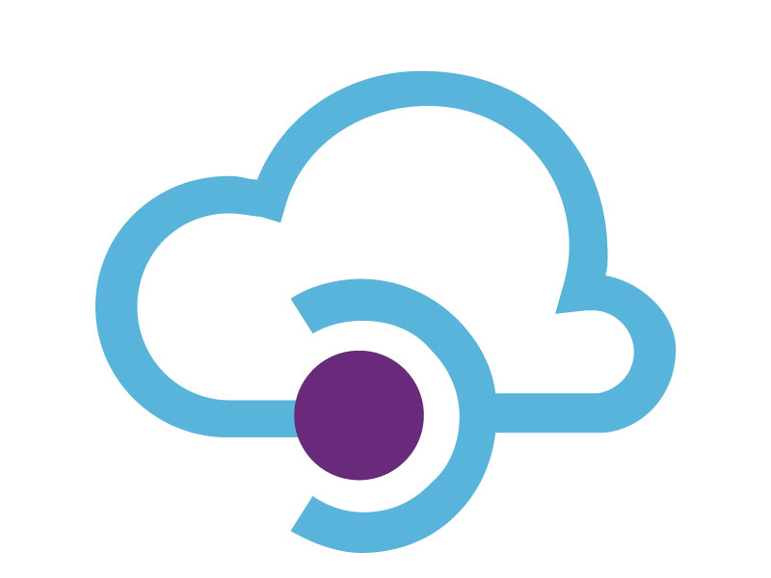


App Services Example

Slide 5

Web Apps
Web apps is a service for hosting web applications, REST APIs, and mobile backends.
Documentation for Web Apps
Developing with .NET on Microsoft Azure

Slide 6

Azure API Apps
API apps is a part of app service that offers an easier way to build, host and consume APIs.
Article about how API Apps are different from Web apps

Slide 7

Swagger & Swashbuckle
Swagger is a machine-readable representation of the RESTful API that provides online documentation support, client-side SDK creation and discoverability.
Swashbuckle is an open source project for creating Swagger documents for web APIs built using ASP.NET Core MVC.
Swagger for ASP.NET Core

Slide 8

Swagger Example
Swagger is used in microservice architecture. You can automatically check a REST endpoints.
Documenting microservices

Slide 9
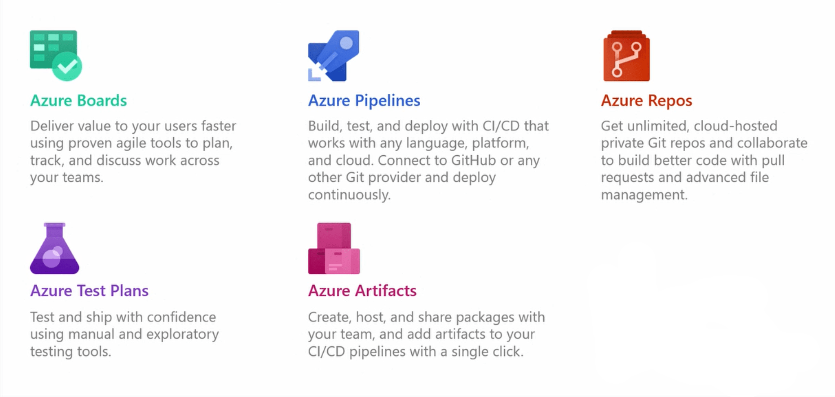
Azure DevOps

Slide 10

Q&A
Credentials:
Konstantin Shvyriaev
Email: Konstantin_Shvyriaev@epam.com

